Slide 1
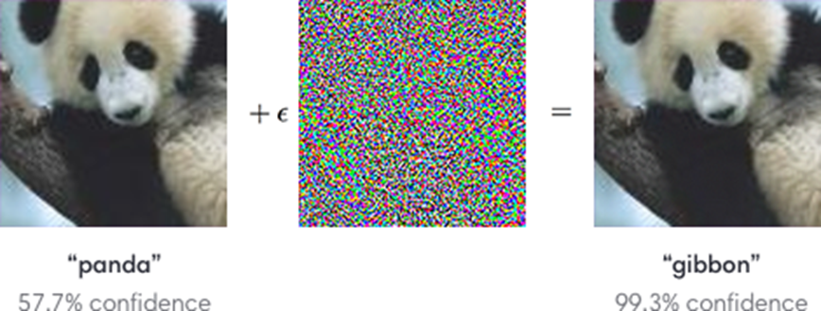
L3.2 Adversarial Attacks
Zonghua Gu, Umeå University
Nov. 2023
Based on ICML 2018 tutorial https://adversarial-ml-tutorial.org

Slide 2
Outline
Adversarial attacks via local search
Physically-realizable attacks
Training adversarially robust models

Slide 3
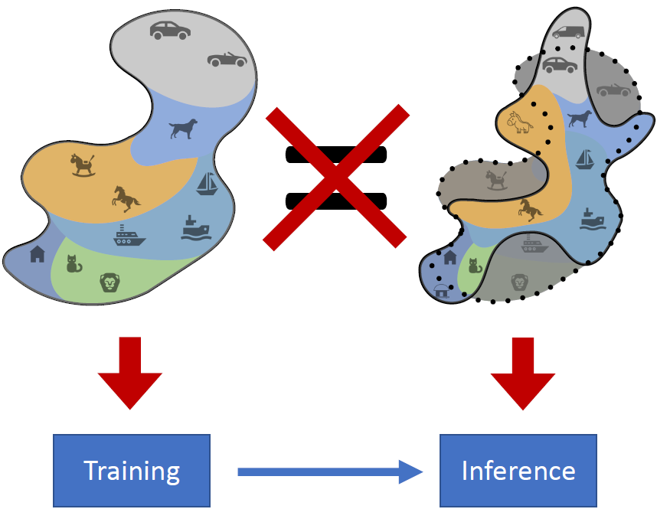
A Limitation of the (Supervised) ML Framework
Distribution Shift: data distribution during inference may NOT be the same as the training dataset
May be naturally occurring, or may be due to adversarial attacks

Slide 4
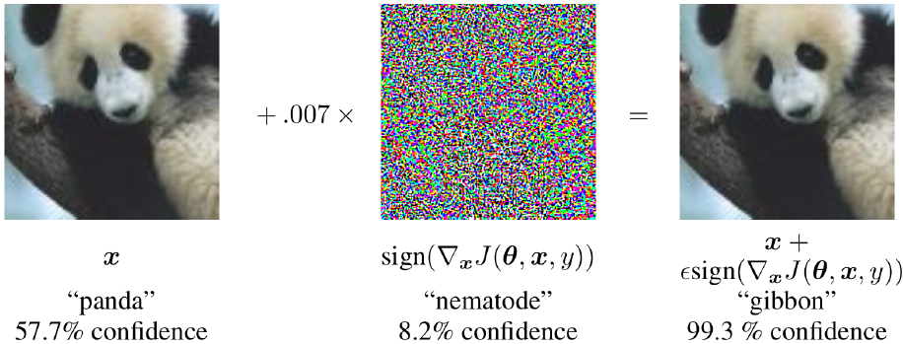
Adversarial Examples
Starting with an image of a panda, the attacker adds a small perturbation that has been calculated to make the image be recognized as a gibbon with high confidence
https://openai.com/blog/adversarial-example-research/

Slide 5
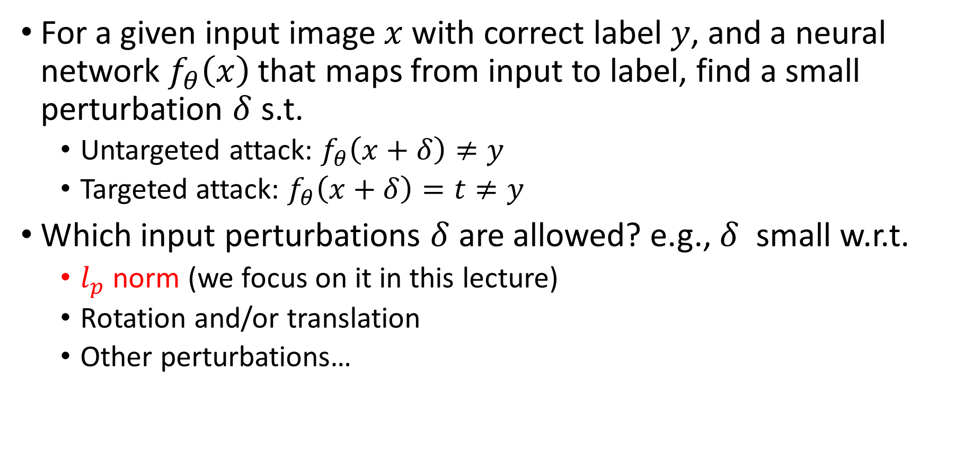
Adversarial Attacks w. Input Perturbation
For a given input image $x$ with correct label $y$, and a neural network $f_{θ}\left(x\right)$ that maps from input to label, find a small perturbation $δ$ s.t.
Untargeted attack: $f_{θ}\left(x+δ\right)≠y$
Targeted attack: $f_{θ}\left(x+δ\right)=t≠y$
Which input perturbations $δ$ are allowed? e.g., $δ$ small w.r.t.
$l_{p}$ norm (we focus on it in this lecture)
Rotation and/or translation
Other perturbations…

Slide 6
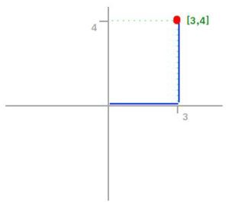
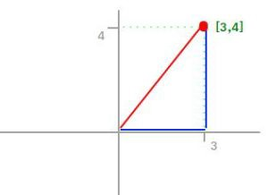
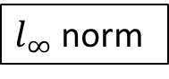
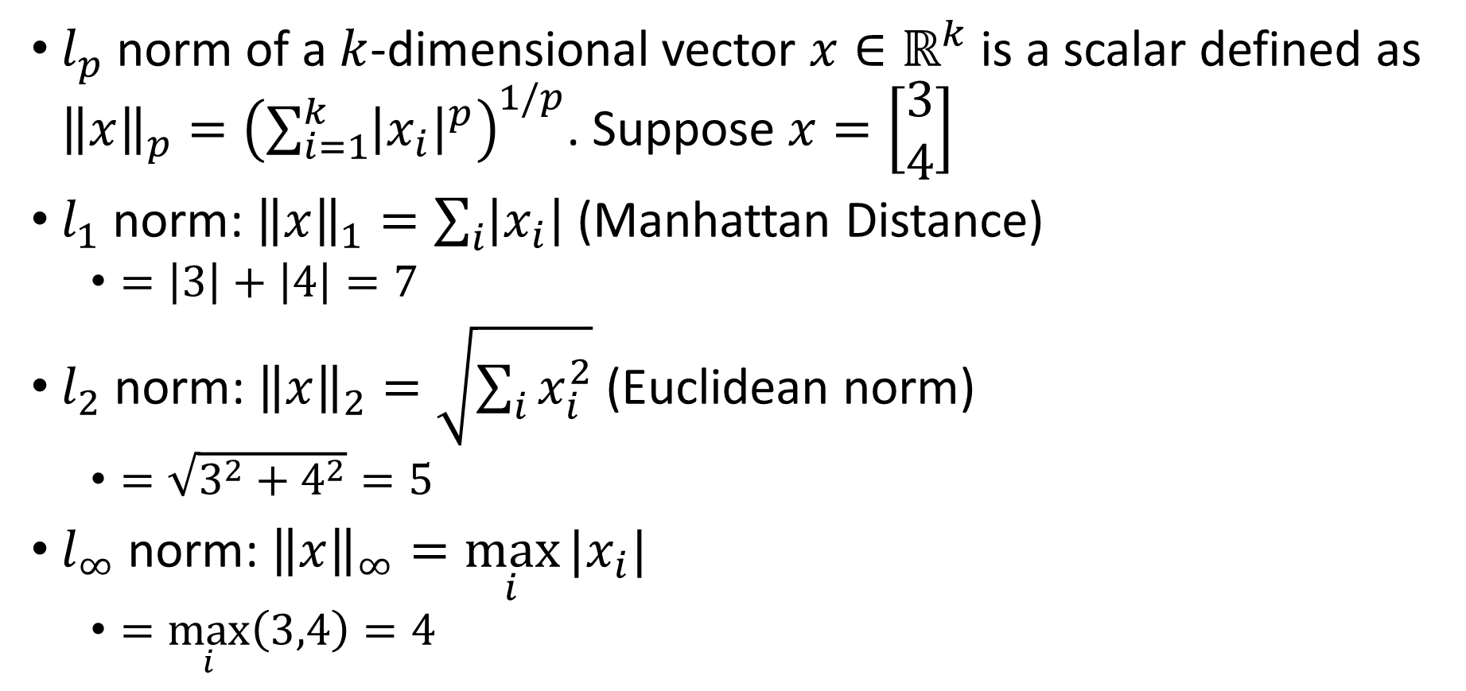
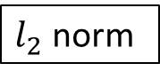
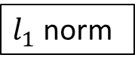
Vector Norms
$l_{p}$ norm of a $k$-dimensional vector $x∈ℝ^{k}$ is a scalar defined as ${\left\|x\right\|}_{p}={\left(\sum_{i=1}^{k}{{\left|x_{i}\right|}^{p}}\right)}^{1/p}$. Suppose $x=\left[\begin{matrix}3 \\ 4\end{matrix}\right]$
$l_{1}$ norm: ${\left\|x\right\|}_{1}=\sum_{i}{\left|x_{i}\right|}$ (Manhattan Distance)
$=\left|3\right|+\left|4\right|=7$
$l_{2}$ norm: ${\left\|x\right\|}_{2}=\sqrt{\sum_{i}{x_{i}^{2}}}$ (Euclidean norm)
$=\sqrt{3^{2}+4^{2}}=5$
$l_{∞}$ norm: ${\left\|x\right\|}_{∞}=\max_{i}{|x_{i}|}$
$=\max_{i}\left(3,4\right)=4$
$l_{1}$ norm
$l_{2}$ norm
$l_{∞}$ norm
https://montjoile.medium.com/l0-norm-l1-norm-l2-norm-l-infinity-norm-7a7d18a4f40c

Slide 7
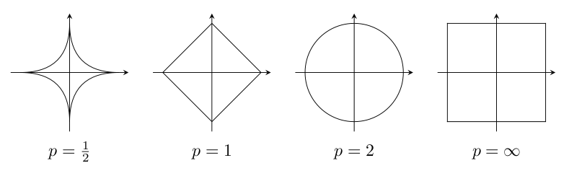
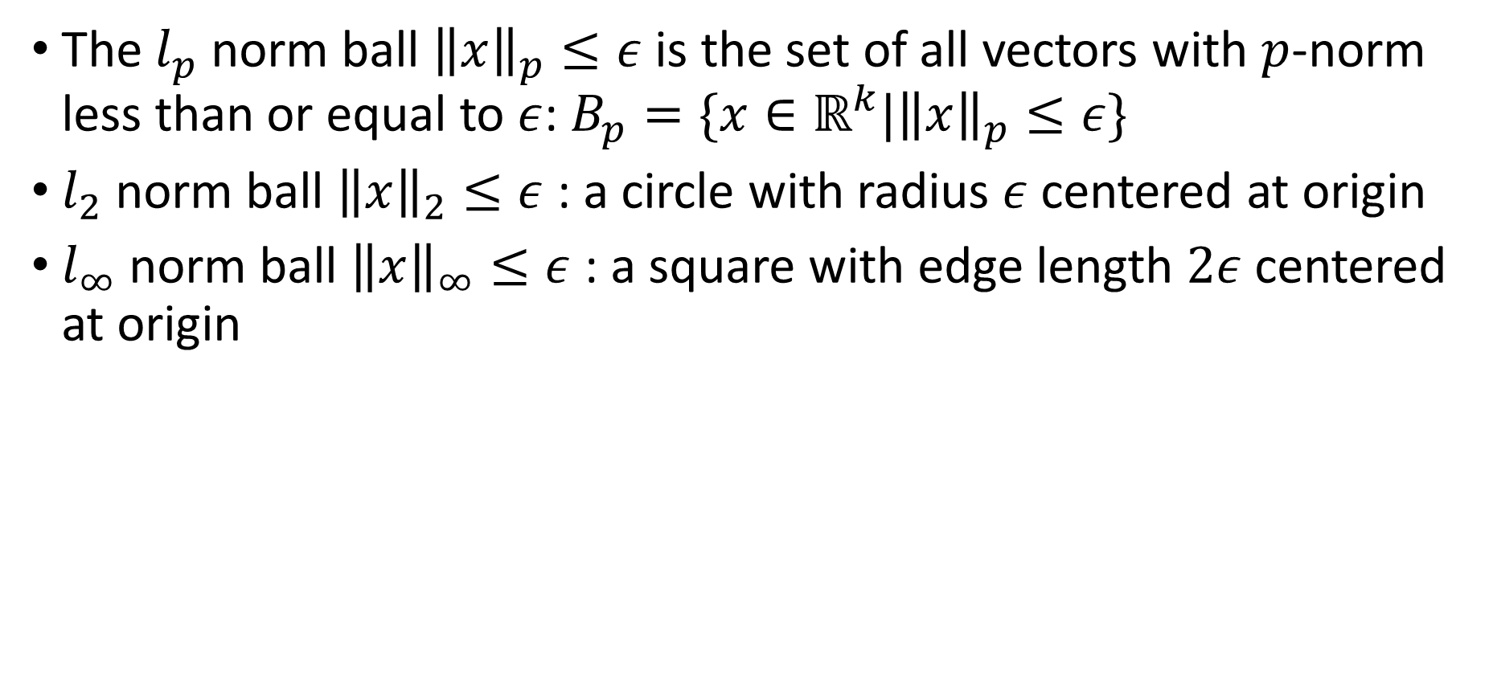
Vector Norm Balls
The $l_{p}$ norm ball ${\left\|x\right\|}_{p}≤ε$ is the set of all vectors with $p$-norm less than or equal to $ε$: $B_{p}=\{x∈ℝ^{k}|{\left\|x\right\|}_{p}≤ε\}$
$l_{2}$ norm ball ${\left\|x\right\|}_{2}≤ε$ : a circle with radius $ε$ centered at origin
$l_{∞}$ norm ball ${\left\|x\right\|}_{∞}≤ε$ : a square with edge length $2ε$ centered at origin
Notes:
https://math.stackexchange.com/questions/2966181/is-vert-x-vert-hm-omega-1-sobolev-norms-always-a-unit-ball-if-you-p

Slide 8
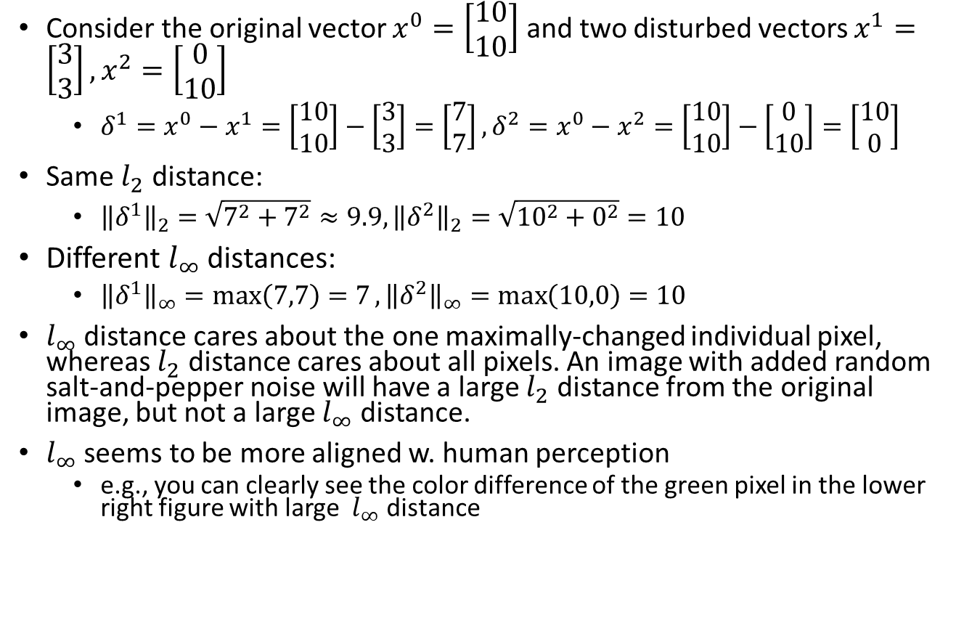
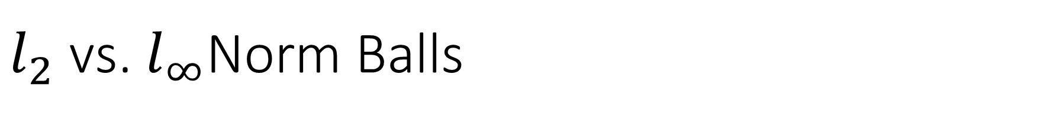
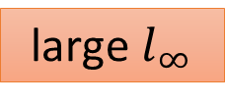
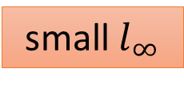
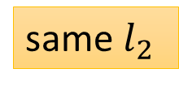
$l_{2}$ vs. $l_{∞}$Norm Balls
Consider the original vector $x^{0}=\left[\begin{matrix}10 \\ 10\end{matrix}\right]$ and two disturbed vectors $x^{1}=\left[\begin{matrix}3 \\ 3\end{matrix}\right],x^{2}=\left[\begin{matrix}0 \\ 10\end{matrix}\right]$
$δ^{1}=x^{0}−x^{1}=\left[\begin{matrix}10 \\ 10\end{matrix}\right]−\left[\begin{matrix}3 \\ 3\end{matrix}\right]=\left[\begin{matrix}7 \\ 7\end{matrix}\right],δ^{2}=x^{0}−x^{2}=\left[\begin{matrix}10 \\ 10\end{matrix}\right]−\left[\begin{matrix}0 \\ 10\end{matrix}\right]=\left[\begin{matrix}10 \\ 0\end{matrix}\right]$
Same $l_{2}$ distance:
${\left\|δ^{1}\right\|}_{2}=\sqrt{7^{2}+7^{2}}≈9.9, {\left\|δ^{2}\right\|}_{2}=\sqrt{{10}^{2}+0^{2}}=10$
Different $l_{∞}$ distances:
${\left\|δ^{1}\right\|}_{∞}=\max\left(7,7\right)=7, {\left\|δ^{2}\right\|}_{∞}=\max\left(10,0\right)=10$
$l_{∞}$ distance cares about the one maximally-changed individual pixel, whereas $l_{2}$ distance cares about all pixels. An image with added random salt-and-pepper noise will have a large $l_{2}$ distance from the original image, but not a large $l_{∞}$ distance.
$l_{∞}$ seems to be more aligned w. human perception
e.g., you can clearly see the color difference of the green pixel in the lower right figure with large $l_{∞}$ distance
small $l_{∞}$
Change every pixel a little bit
same $l_{2}$
Change one pixel much
large $l_{∞}$

Slide 9
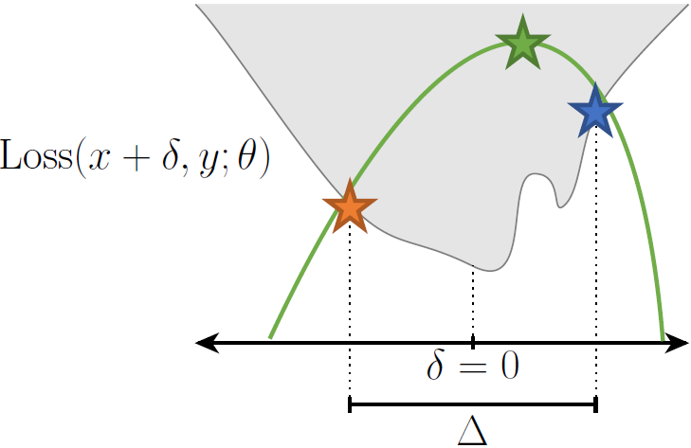
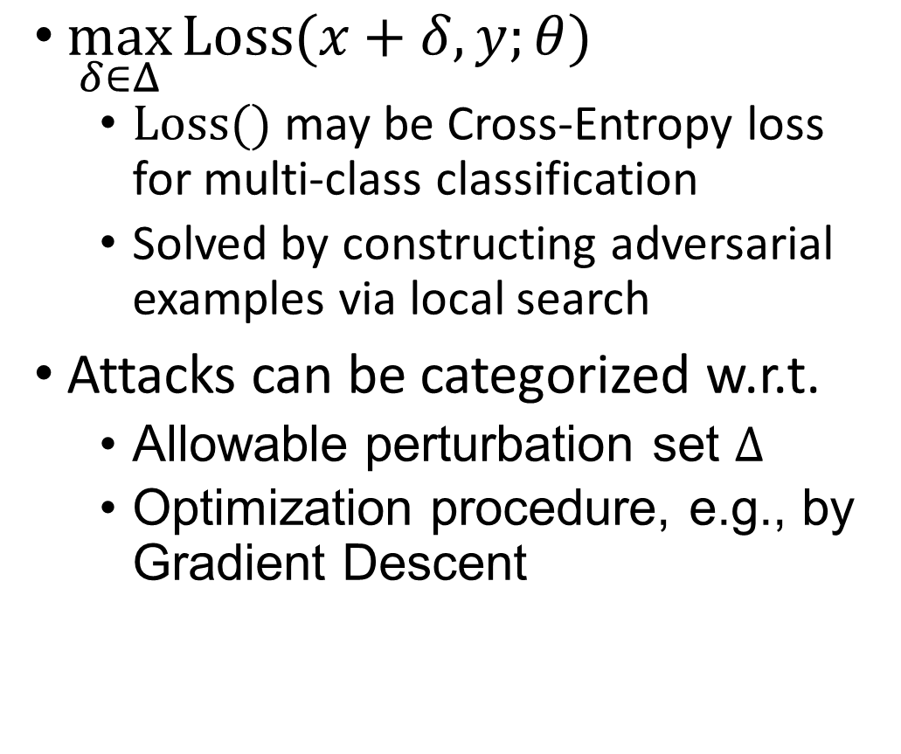
Maximization Problem for Finding Adversarial Examples
$\max_{δ∈Δ}{Loss(x+δ,y;θ)}$
$Loss()$ may be Cross-Entropy loss for multi-class classification
Solved by constructing adversarial examples via local search
Attacks can be categorized w.r.t.
Allowable perturbation set $Δ$
Optimization procedure, e.g., by Gradient Descent
Max
Min

Slide 10
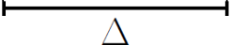
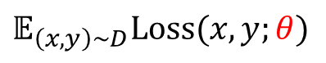
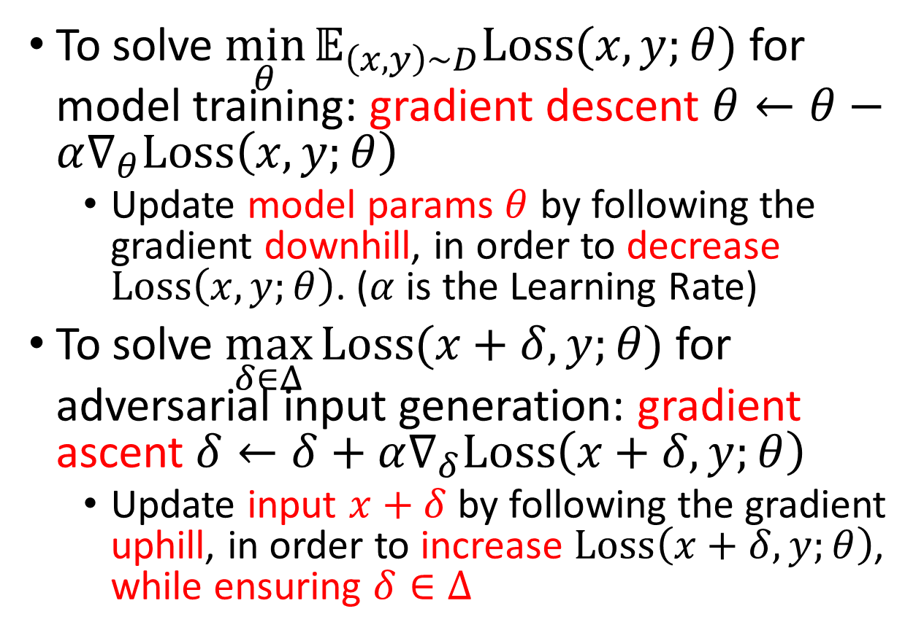

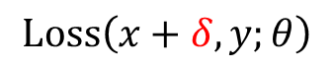

Model Training vs. Local Search for Adversarial Input Generation
To solve $\min_{θ}{𝔼_{\left(x,y\right)∼D}Loss(x,y;θ)}$ for model training: gradient descent $θ←θ−α∇_{θ}Loss\left(x,y;θ\right)$
Update model params $θ$ by following the gradient downhill, in order to decrease $Loss\left(x,y;θ\right)$. ($α$ is the Learning Rate)
To solve $\max_{δ∈Δ}{Loss(x+δ,y;θ)}$ for adversarial input generation: gradient ascent $δ←δ+α∇_{δ}Loss\left(x+δ,y;θ\right)$
Update input $x+δ$ by following the gradient uphill, in order to increase $Loss\left(x+δ,y;θ\right)$, while ensuring $δ∈Δ$
$$𝔼_{\left(x,y\right)∼D}Loss(x,y;θ)$$
$$θ$$
$$Loss\left(x+δ,y;θ\right)$$
$$δ$$

Slide 11
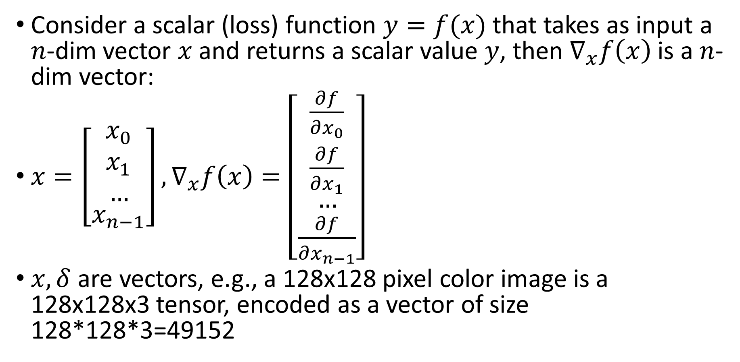
Aside: Vector Derivative
Consider a scalar (loss) function $y=f(x)$ that takes as input a $n$-dim vector $x$and returns a scalar value $y$, then $∇_{x}f\left(x\right)$ is a $n$-dim vector:
$x=\left[\begin{aligned}\begin{matrix}x_{0} \\ x_{1} \\ …\end{matrix} \\ x_{n−1}\end{aligned}\right],∇_{x}f\left(x\right)=\left[\begin{aligned}\begin{matrix}\frac{∂f}{∂x_{0}} \\ \frac{∂f}{∂x_{1}} \\ …\end{matrix} \\ \frac{∂f}{∂x_{n−1}}\end{aligned}\right]$
$x,δ$ are vectors, e.g., a 128x128 pixel color image is a 128x128x3 tensor, encoded as a vector of size 128*128*3=49152

Slide 12
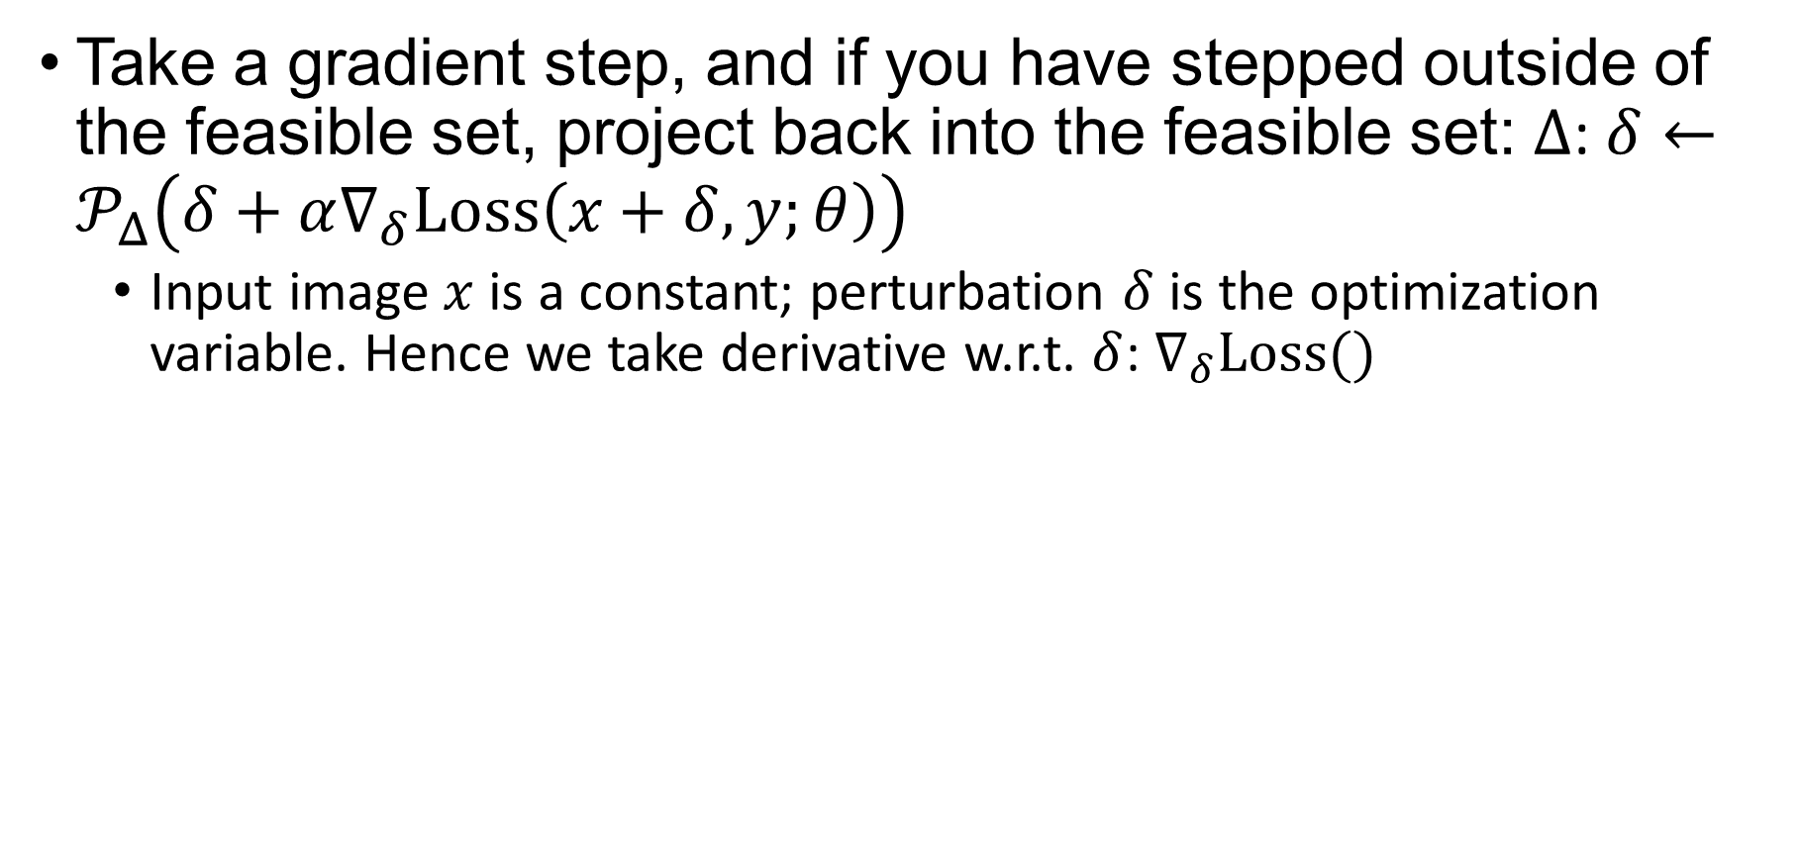
Projected Gradient Descent (PGD)
Take a gradient step, and if you have stepped outside of the feasible set, project back into the feasible set: $Δ$: $δ←𝒫_{Δ}\left(δ+α∇_{δ}Loss\left(x+δ,y;θ\right)\right)$
Input image $x$ is a constant; perturbation $δ$ is the optimization variable. Hence we take derivative w.r.t. $δ$: $∇_{δ}Loss()$

Slide 13
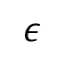
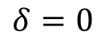
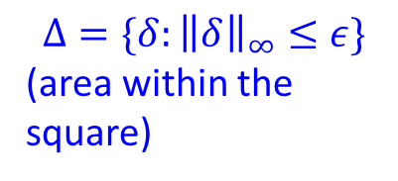
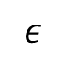
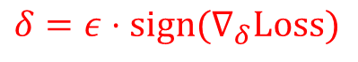
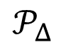
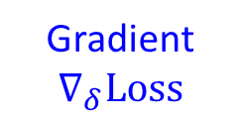
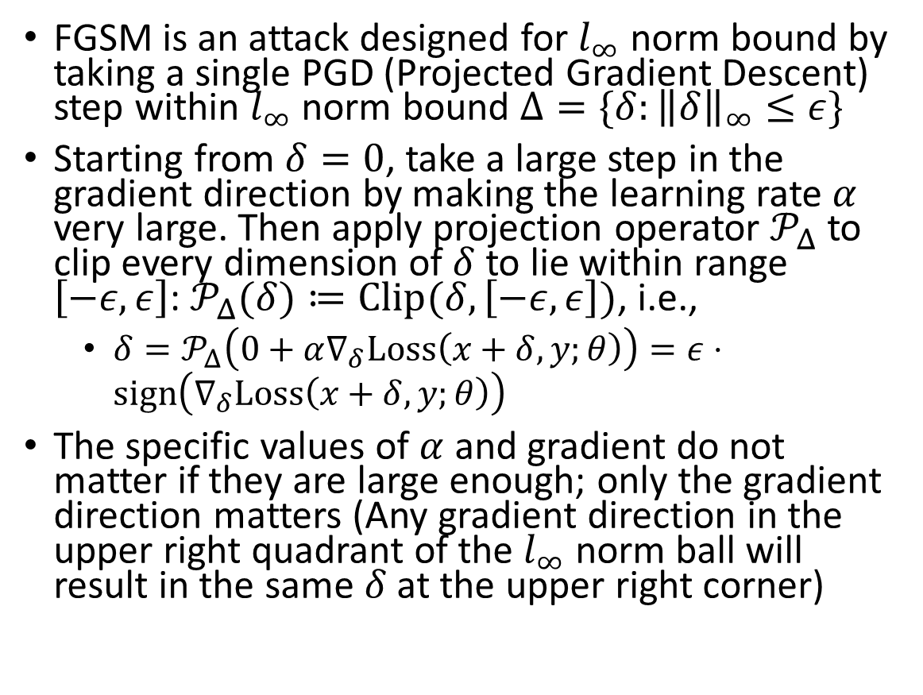
Fast Gradient Sign Method (FGSM)
FGSM is an attack designed for $l_{∞}$ norm bound by taking a single PGD (Projected Gradient Descent) step within $l_{∞}$ norm bound ${Δ=\{δ:\left\|δ\right\|}_{∞}≤ε\}$
Starting from $δ=0$, take a large step in the gradient direction by making the learning rate $α$ very large. Then apply projection operator $𝒫_{Δ}$ to clip every dimension of $δ$ to lie within range $\left[−ε,ε\right]$: $𝒫_{Δ}(δ)≔Clip(δ, \left[−ε,ε\right])$, i.e.,
$δ=𝒫_{Δ}\left(0+α∇_{δ}Loss\left(x+δ,y;θ\right)\right)=ε⋅sign\left(∇_{δ}Loss\left(x+δ,y;θ\right)\right)$
The specific values of $α$ and gradient do not matter if they are large enough; only the gradient direction matters (Any gradient direction in the upper right quadrant of the $l_{∞}$ norm ball will result in the same $δ$ at the upper right corner)
Gradient $∇_{δ}Loss$
$$𝒫_{Δ}$$
$$δ=ε⋅sign(∇_{δ}Loss)$$
$$ε$$
$$δ=0$$
$$ε$$
$${Δ=\{δ:\left\|δ\right\|}_{∞}≤ε\}$$
(area within the square)

Slide 14
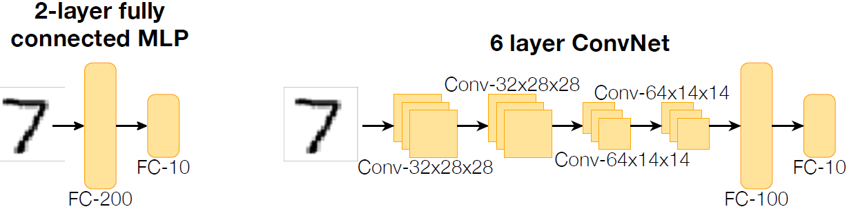
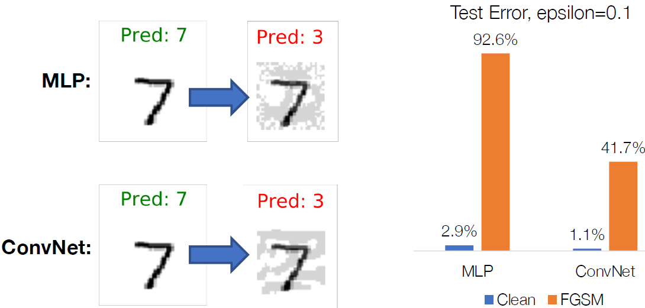
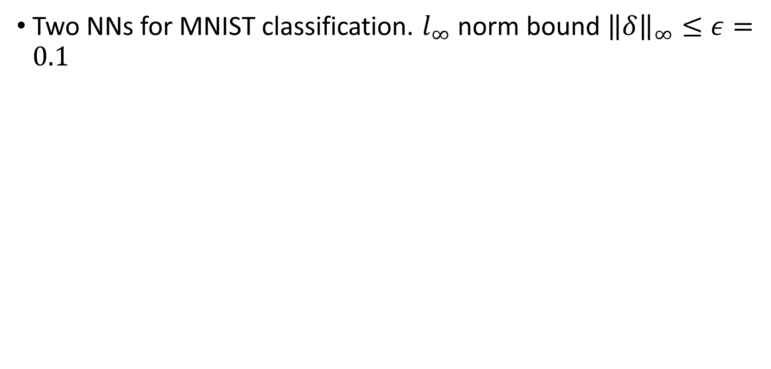
Adversarial Examples by FGSM
Two NNs for MNIST classification. $l_{∞}$ norm bound ${\left\|δ\right\|}_{∞}≤ε=0.1$

Slide 15
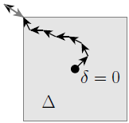
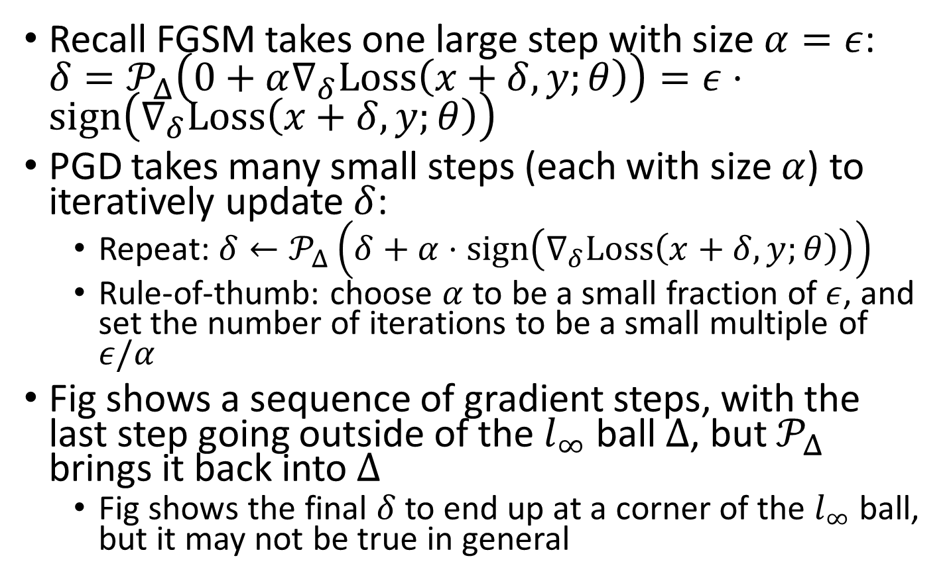
PGD w. Small Steps
Recall FGSM takes one large step with size $α=ε$: $δ=𝒫_{Δ}\left(0+α∇_{δ}Loss\left(x+δ,y;θ\right)\right)=ε⋅sign\left(∇_{δ}Loss\left(x+δ,y;θ\right)\right)$
PGD takes many small steps (each with size $α$) to iteratively update $δ$:
Repeat: $δ←𝒫_{Δ}\left(δ+α⋅sign\left(∇_{δ}Loss\left(x+δ,y;θ\right)\right)\right)$
Rule-of-thumb: choose $α$ to be a small fraction of $ε$, and set the number of iterations to be a small multiple of $ε/α$
Fig shows a sequence of gradient steps, with the last step going outside of the $l_{∞}$ ball $Δ$, but $𝒫_{Δ}$ brings it back into $Δ$
Fig shows the final $δ$ to end up at a corner of the $l_{∞}$ ball, but it may not be true in general

Slide 16
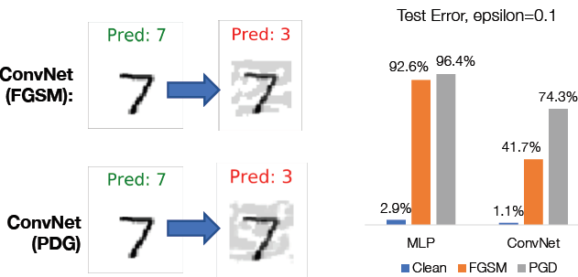
PGD Examples

Slide 17
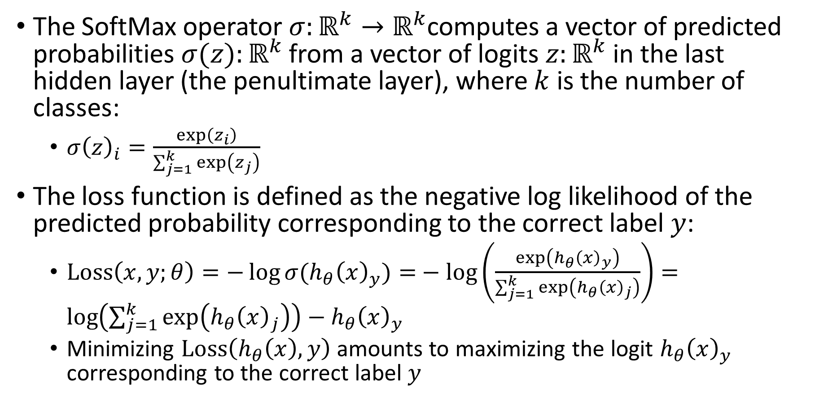
Review: Cross-Entropy Loss for Multi-Class Classification
The SoftMax operator $σ:ℝ^{k}→ℝ^{k}$computes a vector of predicted probabilities $σ(z):ℝ^{k}$ from a vector of logits $z:ℝ^{k}$ in the last hidden layer (the penultimate layer), where $k$ is the number of classes:
$σ{\left(z\right)}_{i}=\frac{\exp\left(z_{i}\right)}{\sum_{j=1}^{k}{\exp\left(z_{j}\right)}}$
The loss function is defined as the negative log likelihood of the predicted probability corresponding to the correct label $y$:
$Loss\left(x,y;θ\right)=−\log{σ(h_{θ}{\left(x\right)}_{y})=}−\log\left(\frac{\exp\left(h_{θ}{\left(x\right)}_{y}\right)}{\sum_{j=1}^{k}{\exp\left(h_{θ}{\left(x\right)}_{j}\right)}}\right)=\log\left(\sum_{j=1}^{k}{\exp\left(h_{θ}{\left(x\right)}_{j}\right)}\right)−h_{θ}{\left(x\right)}_{y}$
Minimizing $Loss\left(h_{θ}\left(x\right),y\right)$ amounts to maximizing the logit $h_{θ}{\left(x\right)}_{y}$ corresponding to the correct label $y$

Slide 18
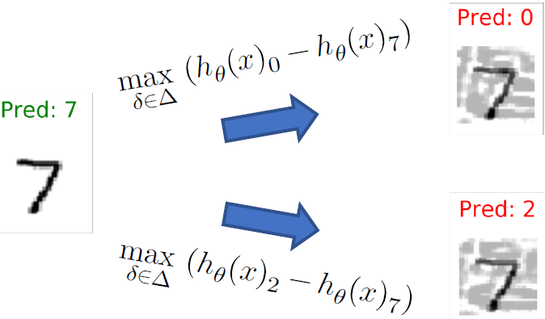
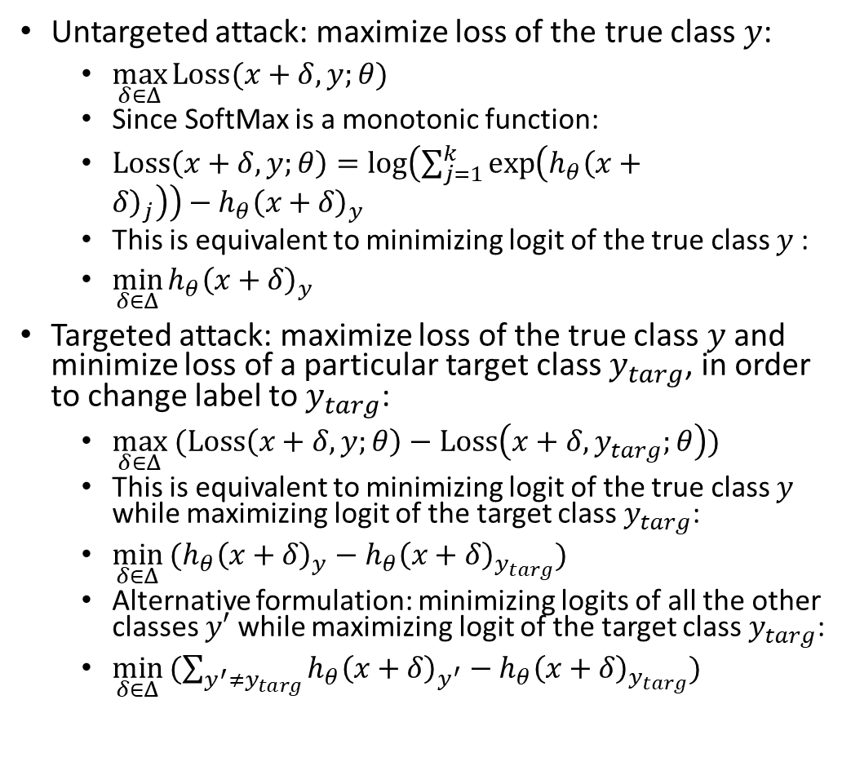
Untargeted vs. Targeted Attacks
Untargeted attack: maximize loss of the true class $y$:
$\max_{δ∈Δ}{Loss(x+δ,y;θ)}$
Since SoftMax is a monotonic function:
$Loss\left(x+δ,y;θ\right)=\log\left(\sum_{j=1}^{k}{\exp\left(h_{θ}{\left(x+δ\right)}_{j}\right)}\right)−h_{θ}{\left(x+δ\right)}_{y}$
This is equivalent to minimizing logit of the true class $y$:
$\min_{δ∈Δ}{h_{θ}{\left(x+δ\right)}_{y}}$
Targeted attack: maximize loss of the true class $y$and minimize loss of a particular target class $y_{targ}$, in order to change label to $y_{targ}$:
$\max_{δ∈Δ}{(Loss\left(x+δ,y;θ\right)−Loss\left(x+δ,y_{targ};θ\right)})$
This is equivalent to minimizing logit of the true class $y$ while maximizing logit of the target class $y_{targ}$:
$\min_{δ∈Δ}{(h_{θ}{\left(x+δ\right)}_{y}−h_{θ}{\left(x+δ\right)}_{y_{targ}})}$
Alternative formulation: minimizing logits of all the other classes $y′$ while maximizing logit of the target class $y_{targ}$:
$\min_{δ∈Δ}{(\sum_{y^{′}≠y_{targ}}{h_{θ}{\left(x+δ\right)}_{y^{′}}}}−h_{θ}{\left(x+δ\right)}_{y_{targ}})$

Slide 19
Outline
Adversarial attacks via local search
Physically-realizable attacks
Training adversarially robust models

Slide 20
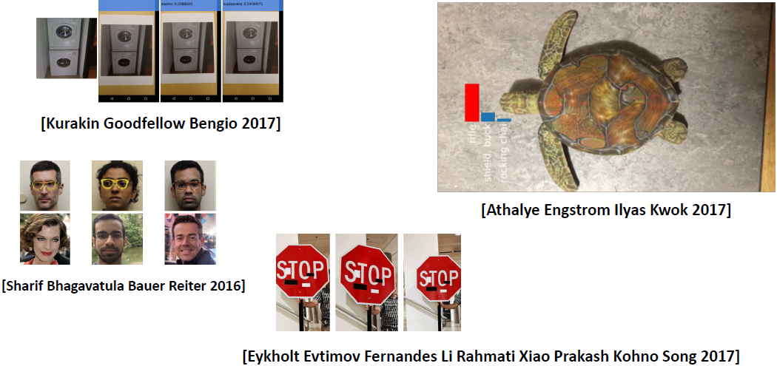
Physically-Realizable Attacks
Instead of directly manipulating pixels, it is possible to modify physical objects and cause miss-classification
[Evtimov et al 2017]: Physical Adversarial Examples Against Deep Neural Networks
https://bair.berkeley.edu/blog/2017/12/30/yolo-attack/

Slide 21
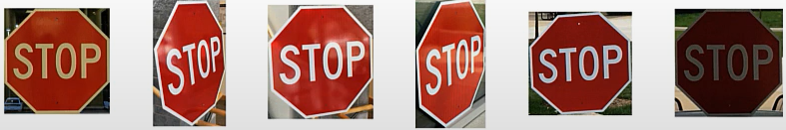
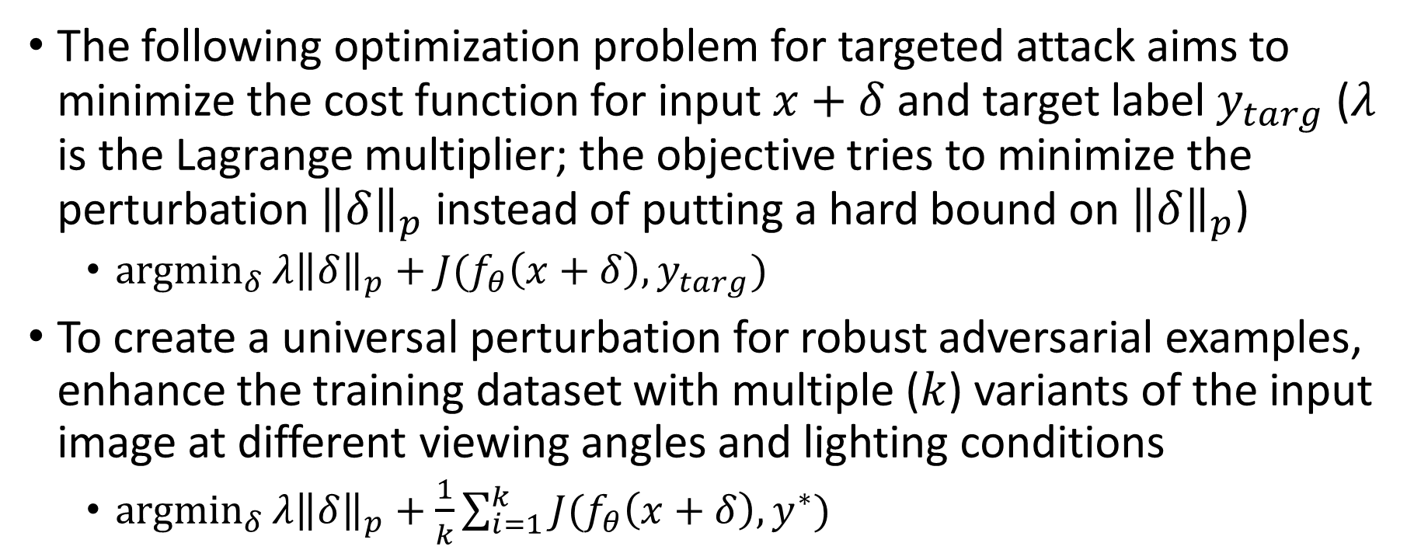
An optimization approach to creating robust adversarial examples
The following optimization problem for targeted attack aims to minimize the cost function for input $x+δ$ and target label $y_{targ}$ ($λ$ is the Lagrange multiplier; the objective tries to minimize the perturbation ${\left\|δ\right\|}_{p}$ instead of putting a hard bound on ${\left\|δ\right\|}_{p}$)
${argmin}_{δ}{λ{\left\|δ\right\|}_{p}+J(f_{θ}\left(x+δ\right),y_{targ})}$
To create a universal perturbation for robust adversarial examples, enhance the training dataset with multiple ($k$) variants of the input image at different viewing angles and lighting conditions
${argmin}_{δ}{λ{\left\|δ\right\|}_{p}+\frac{1}{k}\sum_{i=1}^{k}{J(f_{θ}\left(x+δ\right),y^{∗})}}$

Slide 22
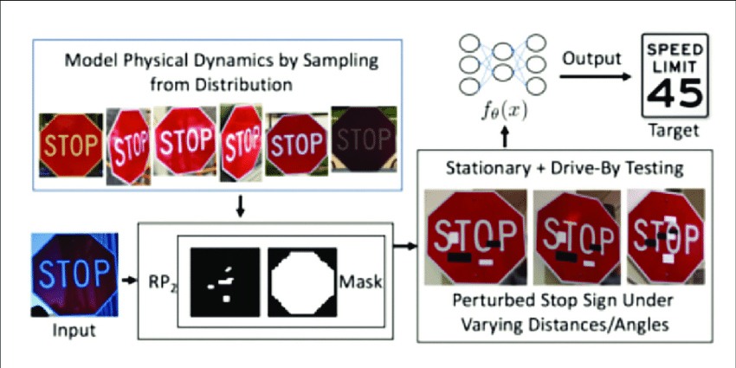
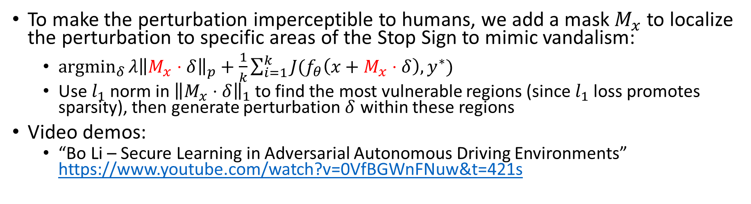
Optimizing Spatial Constraints
To make the perturbation imperceptible to humans, we add a mask $M_{x}$ to localize the perturbation to specific areas of the Stop Sign to mimic vandalism:
${argmin}_{δ}{λ{\left\|M_{x}⋅δ\right\|}_{p}+\frac{1}{k}\sum_{i=1}^{k}{J(f_{θ}\left(x+M_{x}⋅δ\right),y^{∗})}}$
Use $l_{1}$ norm in ${\left\|M_{x}⋅δ\right\|}_{1}$ to find the most vulnerable regions (since $l_{1}$ loss promotes sparsity), then generate perturbation $δ$ within these regions
Video demos:
“Bo Li – Secure Learning in Adversarial Autonomous Driving Environments” https://www.youtube.com/watch?v=0VfBGWnFNuw&t=421s
Notes:
https://www.researchgate.net/publication/351703009_Acquiring_Artificial_Intelligence_Systems_Development_Challenges_Implementation_Risks_and_CostBenefits_Opportunities

Slide 23
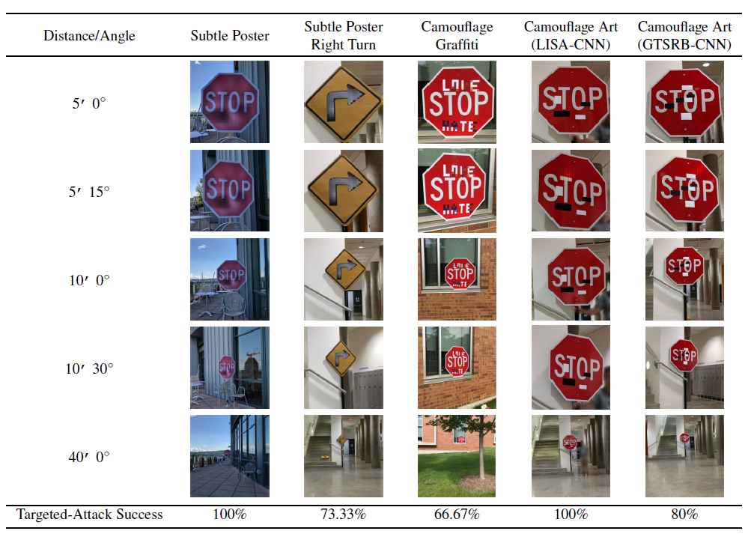
Adversarial Traffic Signs

Slide 24
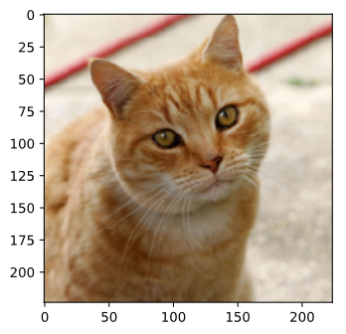

Blackbox Attacks
We have been discussing Whitebox attacks, where we know the NN model parameters 𝜃
Black Box Attacks:
If you have the training dataset of the target Blackbox model:
Train a proxy Whitebox model yourself
Generate attacked objects for the proxy model
If you do not have the training dataset, you can obtain input-output data pairs from the target Blackbox model by invoking online cloud services
May get expensive if the cloud service is not free
Attacked
Input Image
Target
Blackbox Model
Proxy
Whitebox
Model
Training Data

Slide 25
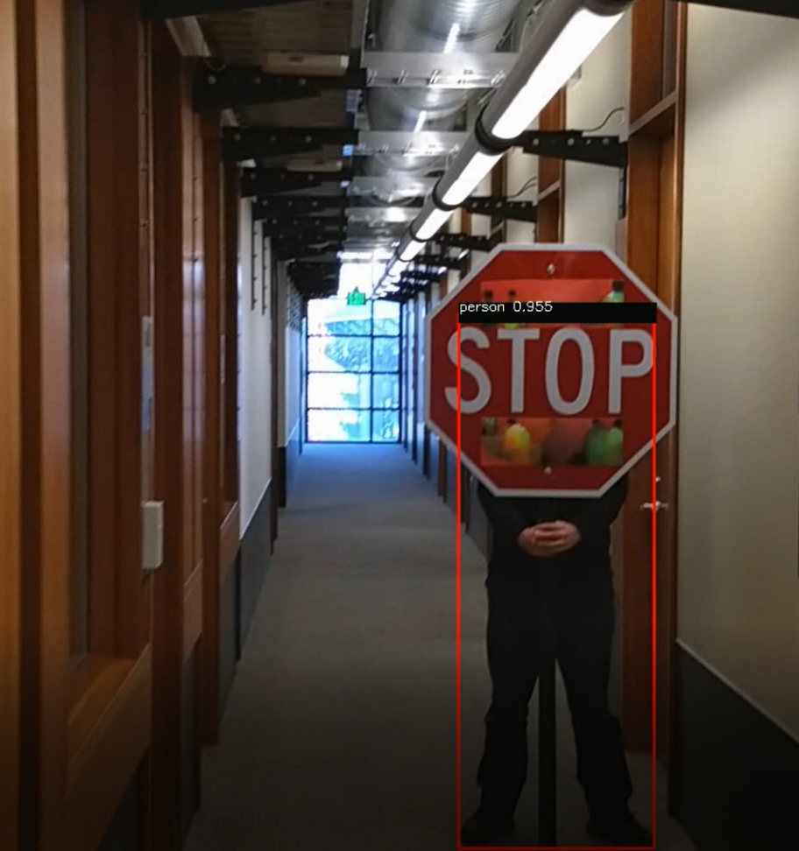
Blackbox Attack Example
[Evtimov et al 2017]: Physical adversarial examples generated for the YOLO object detector (the proxy Whitebox model) are also be able to fool Faster-RCNN (the Blackbox model)

Slide 26



Phantom of the ADAS
A phantom is a depthless presented/projected picture of a 3D object (e.g., pedestrian, traffic sign, car, truck, bicycle…), with the purpose of fooling ADAS to treat it as a real object and trigger an automatic reaction
Phantom attacks by projecting a phantom via a drone equipped with a portable projector:
https://www.youtube.com/watch?v=1cSw4fXYqWI&t=85s
or by presenting a phantom on a hacked roadside digital billboard:
https://www.youtube.com/watch?v=-E0t_s6bT_4
https://www.nassiben.com/phantoms
26

Slide 27



Algorithm for Disguising Phantoms
1. Extract key points as focus areas of human attention for every frame based on the SURF algorithm
2. Compute a local score for every block in a frame that represents how distant a block is from the focus areas, and embed phantoms into “dead areas” that viewers will not focus on
3. Display the phantom in at least $t$ consecutive video frames (longer duration leads to higher success rate)

Slide 28

Constraints on Perturbations
In Phantom of the ADAS attack, phantoms are embedded into “dead areas” that human viewers are not likely to focus on
There is no $δ∈Δ$ norm constraint on the allowable perturbations, since it may not be well-aligned with human perception

Slide 29
Outline
Adversarial attacks via local search
Physically-realizable attacks
Training adversarially robust models

Slide 30


Standard ML vs. Adversarial Robust ML
Standard ML: Empirical Cost Minimization: $\min_{θ}{𝔼_{\left(x,y\right)∼D}Loss(x,y;θ)}$
Adversarial Input Generation (untargeted attack): $\max_{δ∈Δ}{Loss(x+δ,y;θ)}$ (e.g., FGSM, PGD)
Adversarial Robust ML: $\min_{θ}{𝔼_{\left(x,y\right)∼D}\max_{δ∈Δ}{Loss(x+δ,y;θ)}}$
Inner maximization problem: generating an adversarial input by adding a small perturbation $δ$ (or ensuring one does not exist)
Outer minimization problem: training a robust classifier in the presence of adversarial examples
Higher network capacity enables more complex decision boundary and more robust classification
Notes:
Alternative formulation: $\min_{x+δ is adversarial}{δ}$ (e.g., Deepfool, C&W)

Slide 31

Danskin’s Theorem
How to compute the gradient of the objective with the $max⁡$ term inside?
Danskin’s Theorem:
$∇_{y}\max_{x}{f(x,y)}=∇_{y}f(x^{∗},y)$, where $x^{∗}=\underset{x}{argmax}{f(x,y)}$
(Only true when $max$ is performed exactly)
In our case:
$∇_{θ}\max_{δ∈Δ}{Loss(x+δ,y;θ)}=∇_{θ}Loss(x+δ^{∗},y;θ)$, where $δ^{∗}=\underset{δ∈Δ}{argmax}{Loss(x+δ,y;θ)}$
Optimize through the $max⁡$operator by finding the $δ^{∗}$ that maximizes the loss function, then taking gradient at $x+δ^{∗}$

Slide 32


Adversarial Training [Goodfellow et al., 2014]
Adversarial training effectiveness is directly tied to how well we perform the inner maximization. The key issue is incorporate a strong attack into the inner maximization procedure $\min_{θ}{𝔼_{\left(x,y\right)∼D}\max_{δ∈Δ}{Loss(x+δ,y;θ)}}$

Slide 33


What Makes the Models Robust?
The robust model has a smoother loss surface, making it more difficult for an attacker to change the class label with small gradient steps

Slide 34









Loss Surfaces Examples
Upper right fig shows a smooth loss surface with small gradients near the correct label and large distances to other labels, which makes attacks more difficult
Lower right fig shows a less smooth loss surface and small distances to other labels, which makes attacks easier
You can also think of them as 2 different directions on the same loss surface, and the attacker’s goal is to find the optimal direction to change input $x$ (e.g., by gradient ascent with FGSM or PGD)
$$y′$$
$$y$$
$$y′′$$
$$x$$
$$y′$$
$$y$$
$$y′′$$
$$x$$

